Slide 1
Memory Allocation

Slide 2
Why Memory Allocation?
C language allows constants and variables to be processed
All such variables should be maintained in primary memory at the time of execution.
This needs that memory should be allocated to all variables.
There are two ways to allocate memory for data in C
Static allocation
At the time of writing your program, you specify the memory requirement
Dynamic allocation
Allocate memory during run time as and when require

Slide 3
Static Memory Allocation

Slide 4

Static Memory Allocation
Static allocation
Memory requirement should be specified at the time of writing programs
Once the memory allocated it cannot be altered. That is allocated memory remains fixed through out the entire run of the program
Sometimes we create data structures that are “fixed” and don’t need to grow or shrink.
We can not
store > 200
names
int x;
char a[200][20];
x = 555;
int x;
char a[200][20];
x = 555;
√
$$×$$

Slide 5
Static Allocation: Pros and Cons
Done at compile time.
Global variables: variables declared “ahead of time,” such as fixed arrays.
Lifetime
Entire runtime of program.
Advantage
Efficient execution time.
Disadvantage
If we declare more static data space than we need, we waste space.
If we declare less static space than we need, we are out of luck.

Slide 6
Dynamic Memory Allocation

Slide 7
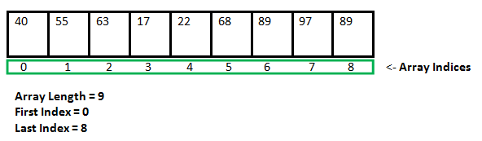
Dynamic Memory Allocation
Since C is a structured language, it has some fixed rules for programming. One of them includes changing the size of an array. An array is a collection of items stored at contiguous memory locations.
As can be seen, the length (size) of the array above is 9. But what if there is a requirement to change this length (size)? For example, If there is a situation where only 5 elements are needed to be entered in this array. In this case, the remaining 4 indices are just wasting memory in this array. So there is a requirement to lessen the length (size) of the array from 9 to 5.Take another situation. In this, there is an array of 9 elements with all 9 indices filled. But there is a need to enter 3 more elements in this array. In this case, 3 indices more are required. So the length (size) of the array needs to be changed from 9 to 12.

Slide 8
Dynamic Memory Allocation
Dynamic allocation (change in size)
Often, real world problems mean that we don’t know how much space to declare, as the number needed will change over time.
At other times, we want to increase and decrease the size of our data structures to accommodate changing needs.
To free space, when a variable is no more required
We can
store > 200
names

Slide 9
Dynamic Allocation: Pros and Cons
Done at run time.
Data structures can grow and shrink to fit changing data requirements.
We can allocate (create) additional storage whenever we need them.
We can de-allocate (free/delete) dynamic space whenever we are done with them.
Advantage:
We can always have exactly the amount of space required - no more, no less.

Slide 10
Memory Allocation Process in C
Local variables
Stack
Free memory
Heap
Global variables
Permanent storage area
Instructions
Notes:
The program instructions and the global variables are stored in a region known as permanent storage area.
The local variables are stored in another area called stack.
The memory space available for dynamic allocation during execution of the program is called heap.
This region is initially kept free.
The size of the heap keeps changing as a program runs.

Slide 11
Memory Allocation Process in C
The program instructions and the global variables are stored in a region known as permanent storage area.
The local variables are stored in another area called stack.
The memory space available for dynamic allocation during execution of the program is called heap.
This region is initially kept free.
The size of the heap keeps changing as a program runs.

Slide 12
Dynamic Memory Allocation
Many a time, we face situations where data is dynamic in nature.
Amount of data cannot be predicted beforehand.
Number of data item keeps changing during program execution.
Such situations can be handled more easily and effectively using dynamic memory management techniques.
C language requires the number of elements in an array to be specified at compile time.
Often leads to wastage or memory space or program failure.
Dynamic Memory Allocation
Memory space required can be specified at the time of execution.
C supports allocating and freeing memory dynamically using library routines.

Slide 13
Memory Allocation Functions
malloc()
Allocates requested number of bytes and returns a pointer to the first byte of the allocated space.
calloc()
Allocates space for an array of elements, initializes them to zero and then returns a pointer to the memory.
free()
Frees previously allocated space.
realloc()
Modifies the size of previously allocated space.

Slide 14
Allocating a Block of Memory
A block of memory can be allocated using the function malloc().
Reserves a block of memory of specified size and returns a pointer of type void.
The return pointer can be assigned to any pointer type.
Syntax
ptr = (type *) malloc (unsigned n);
Returns a pointer to n bytes of uninitialized storage, or NULL if the request cannot be satisfied.

Slide 15
Allocating a Block of Memory
Examples
p = (int *) malloc (100 * sizeof (int));
A memory space equivalent to “100 times the size of an int” bytes is reserved.
The address of the first byte of the allocated memory is assigned to the pointer p of type int.
p
400 bytes of space

Slide 16
Allocating a Block of Memory
cptr = (char *) malloc (20) ;
A memory space of 20 bytes is reserved.
The address of the first byte of the allocated memory is assigned to the pointer cptr of type char.
cptr
20 bytes of space

Slide 17
Points to Note
malloc() always allocates a block of contiguous bytes.
The allocation can fail if sufficient contiguous memory space is not available.
If it fails, malloc() returns NULL.

Slide 18
Example: malloc()
#include <stdio.h>
#include <stdlib.h>
void main()
{
int i, N;
float *height;
float sum = 0, avg;
printf("Input the number of students. \n");
scanf("%d",&N);
height=(float *)malloc(N * sizeof(float));
printf("Input heights for %d students \n", N);
for(i=0;i<N;i++)
scanf("%f",&height[i]);
for(i=0;i<N;i++)
sum += height[i];
avg = sum/(float) N;
printf("Average height= %f \n", avg);
}
Output!
Input the number of students.
5
Input heights for 5 students
23 24 25 26 27
Average height= 25.000000
Notes:
This program dynamically allocates memory for storing heights of N students, then calculates and displays their average height.
It reads the number of students, allocates a float array for their heights, sums all heights, and computes the average.

Slide 19
calloc()
The C library function
void *calloc(unsigned n, unsigned size)
Allocates the requested memory and returns a pointer to it.
Allocates a block of memory for an array of n elements, each of them size bytes long, and initializes all its bits to zero.
Example
int n;
int *x;
. . .
x = (int *) calloc(n, sizeof(int));
int x[n];

Slide 20
Example: calloc()
#include <stdio.h> /* printf, scanf, NULL */
#include <stdlib.h> /* calloc, exit, free */
int main ()
{
int i, n;
int *pData;
printf ("Amount of numbers to be entered: ");
scanf ("%d",&n);
pData = (int*) calloc (n, sizeof(int));
if (pData == NULL) exit (1);
for (i=0;i<n;i++)
{
printf ("Enter number #%d: ",i+1);
scanf ("%d",&pData[i]);
}
printf ("You have entered: ");
for (i=0;i<n;i++)
printf ("%d ",pData[i]);
return 0;
}
Output!
Amount of numbers to be entered: 5
Enter number #1: 23
Enter number #2: 31
Enter number #3: 23
Enter number #4: 45
Enter number #5: 32
You have entered: 23 31 23 45 32

Slide 21
calloc() versus malloc()
void *malloc (unsigned n);
void *calloc(unsigned n, unsigned size)
malloc() takes a single argument (memory required in bytes), while calloc() needs two arguments.
malloc() does not initialize the memory allocated, while calloc() initializes the allocated memory to ZERO.

Slide 22
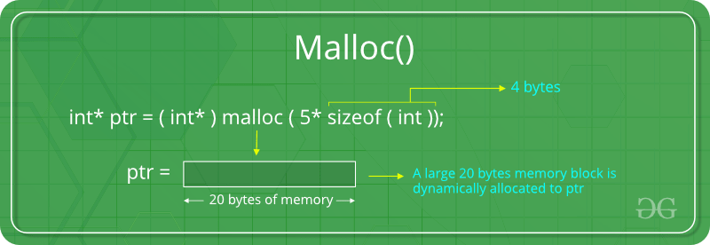
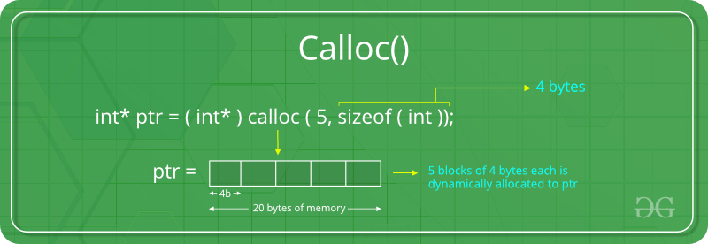

Slide 23
Releasing the Used Space
When we no longer need the data stored in a block of memory, we may release the block for future use.
How?
By using the free() function.
Syntax
free (ptr) ;
where ptr is a pointer to a memory block which has been already created using malloc() or calloc() or realloc() ;

Slide 24
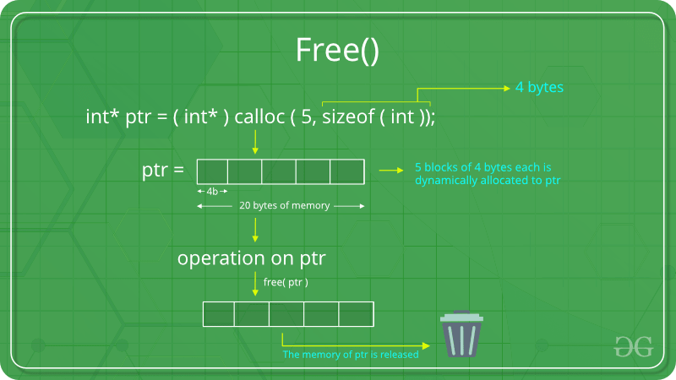

Slide 25
realloc(): Altering the Size of a Block
Sometimes we need to alter the size of some previously allocated memory block.
More memory needed.
Memory allocated is larger than necessary.
How?
By using the realloc() function.
If the original allocation is done by the statement
ptr = malloc (size);
Then reallocation of space may be done as
ptr = realloc (ptr, newsize) ;

Slide 26
realloc(): Altering the Size of a Block
The new memory block may or may not begin at the same place as the old one.
If it does not find space, it will create it in an entirely different region and move the contents of the old block into the new block.
The function guarantees that the old data remains intact.
If it is unable to allocate, it returns NULL. But, it does not free the original block.

Slide 27
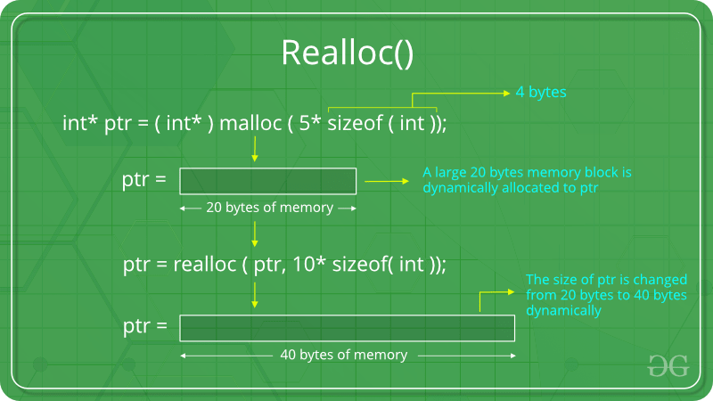

Slide 28
Example: realloc()
#include <stdio.h>
#include <stdlib.h>
int main(void)
{
int *pa, *pb, n; /* allocate an array of 10 int */
pa = (int *)malloc(10 * sizeof (int));
if(pa) {
printf("%u bytes allocated. Storing integers: ", 10*sizeof(int));
for(n = 0; n < 10; ++n)
printf("%d ", pa[n] = n);
} // reallocate array to a larger size
pb = (int *)realloc(pa, 1000000 * sizeof(int));
if(pb) {
printf("\n%u bytes are allocated, after the first 10 integers are: ", 1000000*sizeof(int));
for(n = 0; n < 10; ++n)
printf("%d ", pb[n]); // show the array
free(pb);
}
else { // if realloc failed, the original pointer needs to be freed
free(pa);
}
return 0;
}
Output!
40 bytes allocated. Storing ints: 0 1 2 3 4 5 6 7 8 9
4000000 bytes allocated, first 10 ints are: 0 1 2 3 4 5 6 7 8 9
Notes:
This program demonstrates dynamic memory allocation using malloc and realloc to resize an array from 10 integers to 1 million integers.
It initially allocates memory for 10 integers, stores values 0-9, then uses realloc to dramatically increase the array size while preserving the original data, showing how memory can be dynamically resized during program execution.

Slide 29
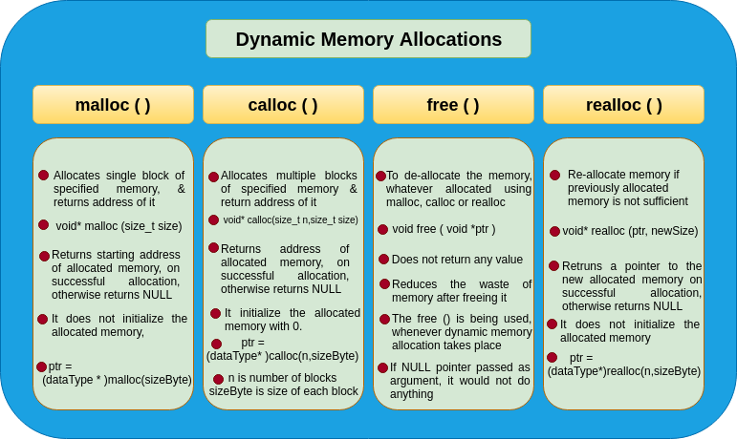

Slide 30
Lab – Q1
Question: Write a C program that dynamically allocates an array of n student records, where each record has name (no spaces) and grade (float). Read all n records, print them in order, and compute & print the class average. Use malloc for the array and free it at the end.
Sample Input
3 Alice 85.5 Bharat 92.0 Chitra 78.5
Expected Output
Student Records: 1) Name: Alice Grade: 85.50 2) Name: Bharat Grade: 92.00 3) Name: Chitra Grade: 78.50 Class Average: 85.33

Slide 31
Lab – Q2
Question: Write a C program that first reads an integer k (number of strings), then reads k lines (varying lengths). Dynamically allocate memory to concatenate them in order (no extra spaces unless provided) into a single string. Print the concatenated string and its length. Use malloc/realloc as needed and free all memory.
Sample Input
4 Hello _ Dynamic World!
Expected Output
Concatenated String: Hello_DynamicWorld! Length: 21

Slide 32
Lab – Q3
Question: Write a C program that dynamically allocates two matrices A and B of size r × c. Read r c, then read A and B. Print A + B.
Sample Input (r c, then A, then B)
2 2 1 2 3 4 5 6 7 8
Expected Output (Addition)
A + B = 6 8 10 12

Slide 33
Lab – Q4
Question: Start with capacity cap = 2 and dynamically allocated int* arr. Repeatedly read integers. When the array is full, double its capacity using realloc and continue. Print the count and all stored values. Free memory before exit.
Sample Input
5 12 7 9 15 21
Expected Output
Stored values (count = 6): 5 12 7 9 15 21

Slide 34
Example: realloc()
#include <stdio.h>
#include <stdlib.h>
int main() {
int *arr1, *arr2;
int n = 5; // Number of elements to allocate
// 1. Using malloc to allocate memory
// malloc allocates uninitialized memory
arr1 = (int*)malloc(n * sizeof(int));
if (arr1 == NULL) {
printf("Memory allocation failed with malloc.\n");
return 1; }
printf("Memory allocated using malloc:\n");
for (int i = 0; i < n; i++) {
arr1[i] = i + 1; // Manually initializing the array
printf("%d ", arr1[i]); }
printf("\n");

Slide 35
Example: realloc()
// calloc allocates memory and initializes it to zero
arr2 = (int*)calloc(n, sizeof(int));
if (arr2 == NULL) {
printf("Memory allocation failed with calloc.\n");
free(arr1); // Free previously allocated memory before exiting
return 1; }
printf("Memory allocated using calloc:\n");
for (int i = 0; i < n; i++) {
printf("%d ", arr2[i]); // All elements should be 0 initially
} printf("\n");
// Free the allocated memory
free(arr1);
free(arr2);
printf("Memory freed successfully.\n");
return 0;}

Slide 36
Explanation
malloc (Memory Allocation):
malloc allocates a block of memory of the specified size (in bytes).
In this code, malloc is used to allocate memory for n integers with malloc(n * sizeof(int)).
The allocated memory is uninitialized, so it may contain garbage values.
After allocation, the code initializes each element of arr1 manually.
calloc (Contiguous Allocation):
calloc allocates memory for an array of elements, initializing each byte to zero.
calloc(n, sizeof(int)) allocates memory for n integers and initializes them to zero.
This example demonstrates that after calloc, all elements in arr2 are initially zero.
free (Memory Deallocation):
After using the allocated memory, free is used to deallocate it and prevent memory leaks.
free(arr1); and free(arr2); release the memory back to the system.

Slide 37
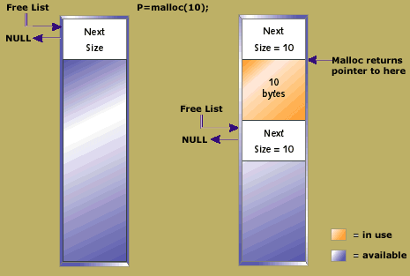
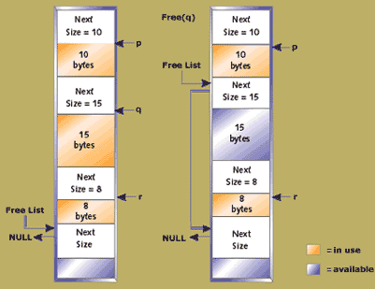

Slide 38
1. What does DMA stand for in computer systems?
A) Data Management Architecture
B) Direct Memory Access
C) Dynamic Memory Access
D) Digital Media Adapter
c
2. Which component is responsible for managing DMA in a computer system?
A) CPU
B) RAM
C) DMA Controller
D) Peripheral Devices
Answer: C) DMA Controller

Slide 39
3. Which of the following is a major advantage of using DMA?
A) Increased CPU load
B) Faster data transfer
C) Decreased power consumption
D) Slower data transfer
Answer: B) Faster data transfer
4. In a DMA transfer, which device has control over the data bus?
A) CPU
B) Memory
C) DMA Controller
D) Hard Disk
Answer: C) DMA Controller
c

Slide 40
Which type of data transfer is DMA most commonly used for?
A) CPU-to-CPU
B) Memory-to-Memory
C) I/O-to-Memory
D) I/O-to-CPU
Answer: C) I/O-to-Memory
6. Which of the following is NOT a common mode of DMA operation?
A) Burst Mode
B) Cycle Stealing Mode
C) Polling Mode
D) Transparent Mode
Answer: C) Polling Mode

Slide 41
Which type of data transfer is DMA most commonly used for?
A) CPU-to-CPU
B) Memory-to-Memory
C) I/O-to-Memory
D) I/O-to-CPU
Answer: C) I/O-to-Memory
6. What is the purpose of the DMA address register?
A) To store the address of the DMA controller
B) To hold the address of the CPU
C) To store the memory address where data will be read or written
D) To save the address of the hard drive
Answer: C) To store the memory address where data will be read or written

Slide 42
. What is the role of the DMA count register?
A) Counts the number of interrupts
B) Indicates the number of bytes to be transferred
C) Stores the current memory address
D) Manages CPU access to DMA
Answer: B) Indicates the number of bytes to be transferred
Which of the following types of devices typically uses DMA for efficient data transfer?
A) Keyboard
B) Mouse
C) Network Interface Card (NIC)
D) CPU
Answer: C) Network Interface Card (NIC)

Slide 43
. In C, a DMA transfer that moves blocks of data is sometimes handled using:
A) Bitwise operations
B) Loop-based transfers
C) DMA-specific functions provided by hardware libraries
D) Standard input-output functions
Answer: C) DMA-specific functions provided by hardware libraries
Which type of memory access can bypass the CPU using DMA?
A) Random access
B) Sequential access
C) Direct access between peripherals and memory
D) Virtual access
Answer: C) Direct access between peripherals and memory

Slide 44
